Slide 1
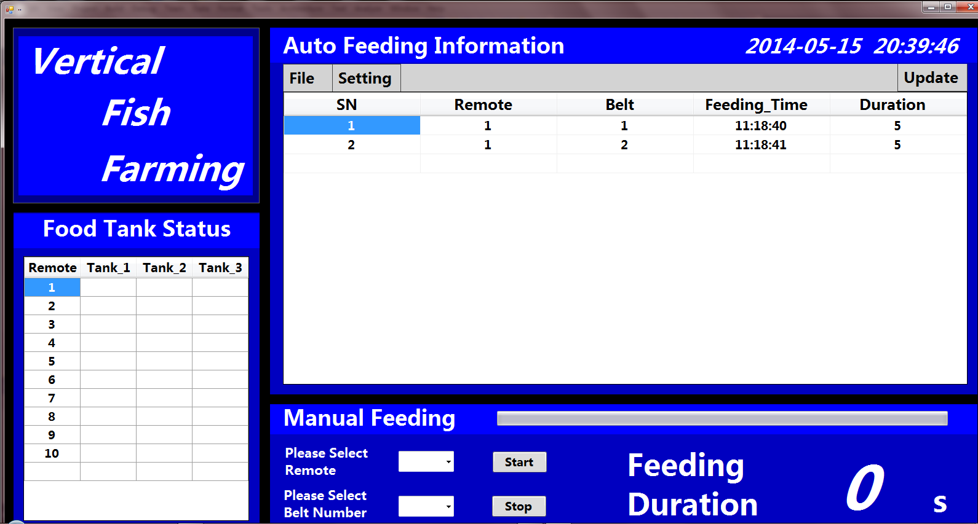
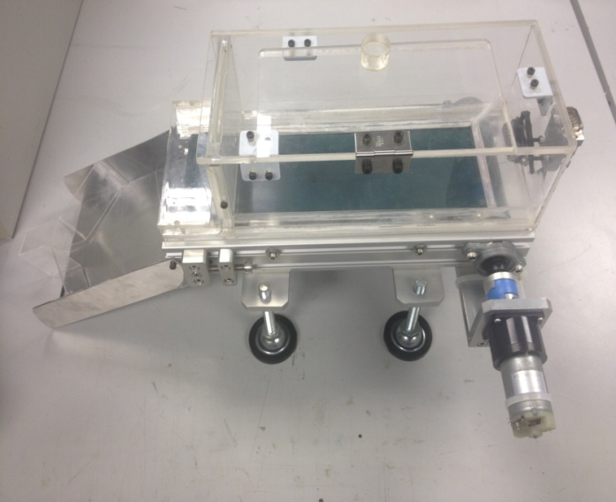

Vertical Fish Farming
Project No: 2B13049
User Interface
Food Container Prototype
Project Description
This project was to develop an automated Fish Farming system. The feeding process was fully-controlled wirelessly via a PC. This system can monitor multiple fish tanks at remote area, via a router using a Remote Wireless module.
This system increases the efficiency of fish farming, in terms of space, manpower, energy and time. It is specially designed for large-scale fish farming industry.
Key Features
Presents user-friendly Interface
Provides automatic fish feeding according to the preset time
Allows remote control by using central PC and Host Module controller
Monitors the food level in the food container
Engineering Project Show
JULY 2014
Notes:
White Background
Vertical Photo Display

Slide 2
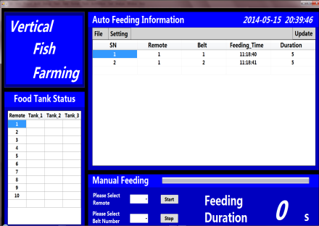

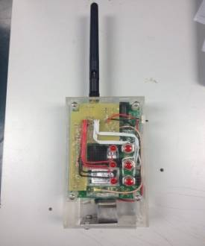
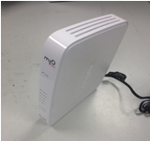

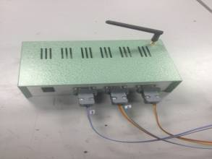

Technical Specifications
This system is able to:
Allow feeding of more than three fish tanks using one Conveyor-belt feeder.
Control three Conveyor-belt feeders using one Rabbit Remote Module
Expand in scale by adding in Rabbit Remote Modules to meet the requirement of large-scale fish feeding
Retrieving feeding data information using Excel file and MySQL database
Allow mobile control using a hand-held Host unit powered by a rechargeable 9V LiPo battery
PC Control User Interface
Host Module
Router
Remote Module
Food Container 1, 2 & 3
Connect
Process Flow
Embedded System Diploma Unit
Students: Xu Sheng, Wang Pengfei & Zhang Sheng
Supervisor: Mr. Foong Chee Hoong (1st supervisor) & Ms. Tay Sioh Hoong (2nd supervisor)
Notes:
White Background
Vertical Photo Display

